Slide 1
https://www.youtube.com/watch?v=-NbY7E9hKxk
NEW FOR 2019: Learn my top 25 pandas tricks! https://www.youtube.com/watch?v=RlIiVeig3hc
My entire pandas video series: https://www.youtube.com/playlist?list...
Working with dates and times: https://www.youtube.com/watch?v=yCgJG...
Using the category data type: https://www.youtube.com/watch?v=wDYDY...
Changing data types: https://www.youtube.com/watch?v=V0AWy...
Using groupby: https://www.youtube.com/watch?v=qy0fD...
== OTHER RESOURCES ==
Jupyter notebook on GitHub: https://github.com/justmarkham/pandas...
pandas release notes: http://pandas.pydata.org/pandas-docs/...
pandas cheat sheet: https://github.com/pandas-dev/pandas/...

Slide 2
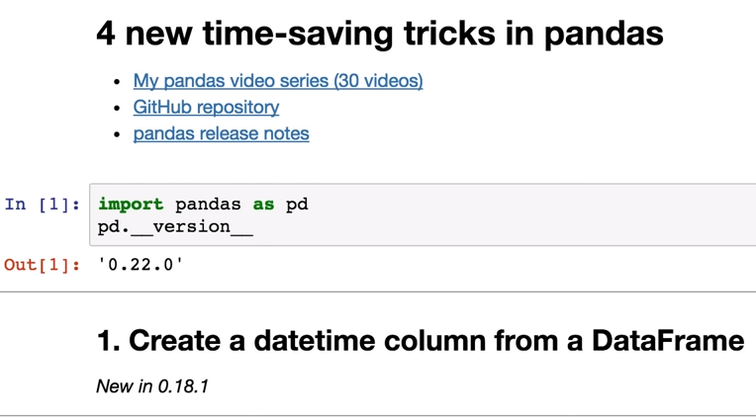
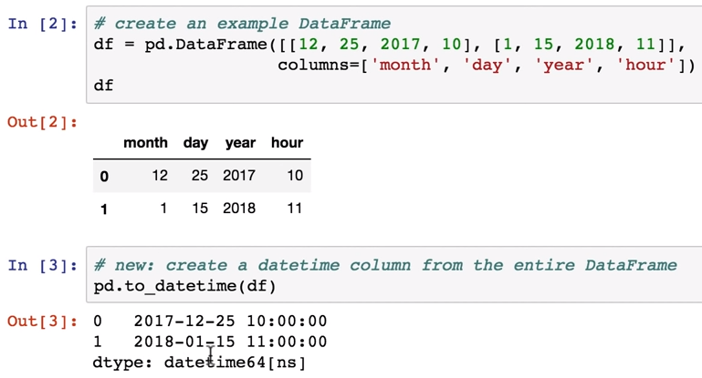

Slide 3
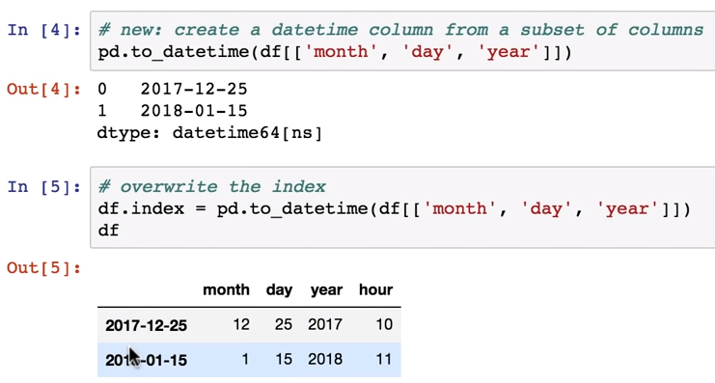

Slide 4
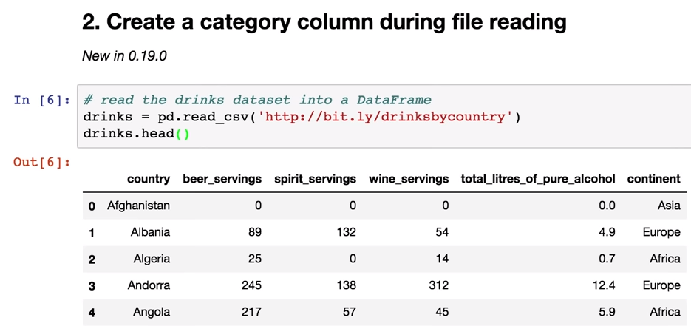
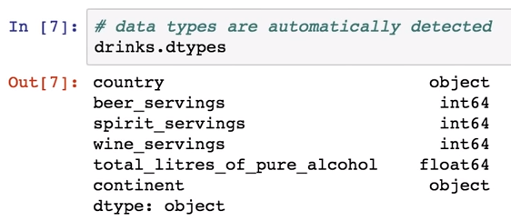

Slide 5
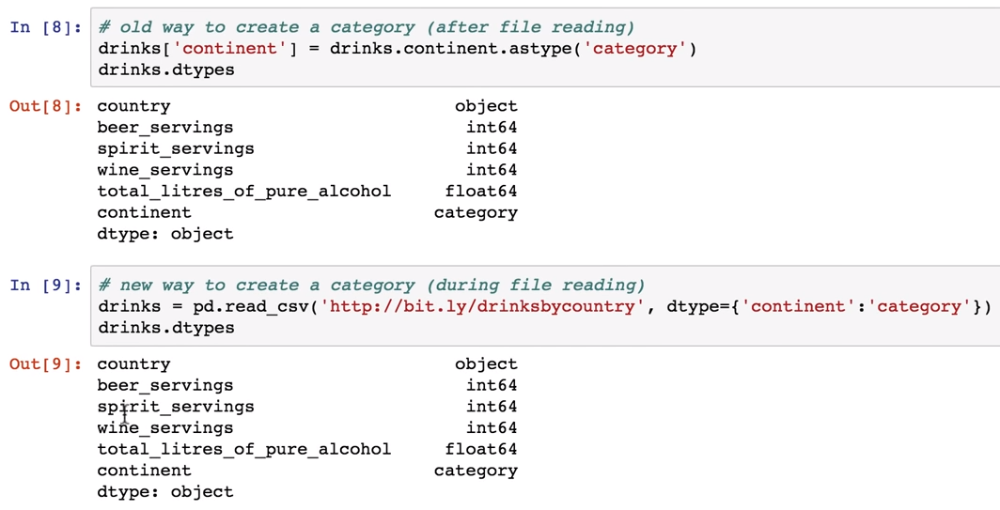

Slide 6
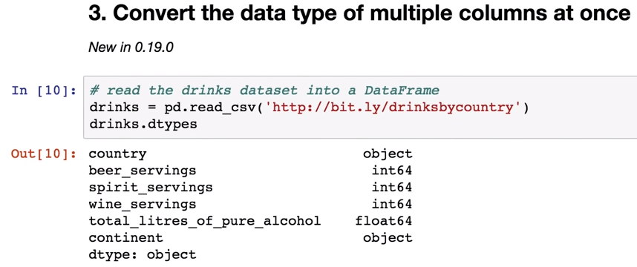

Slide 7
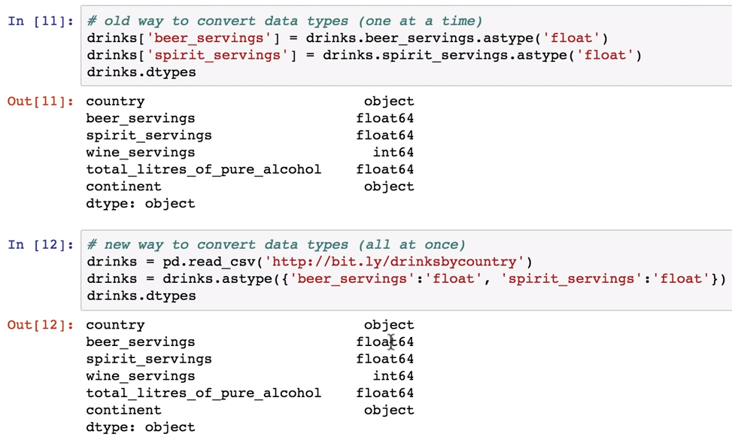

Slide 8
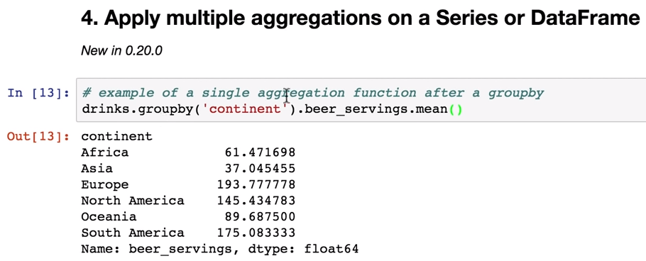

Slide 9
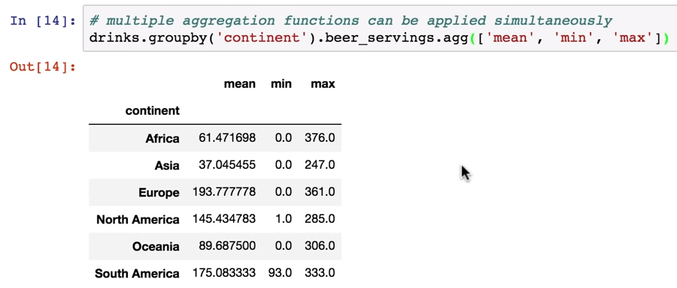

Slide 10
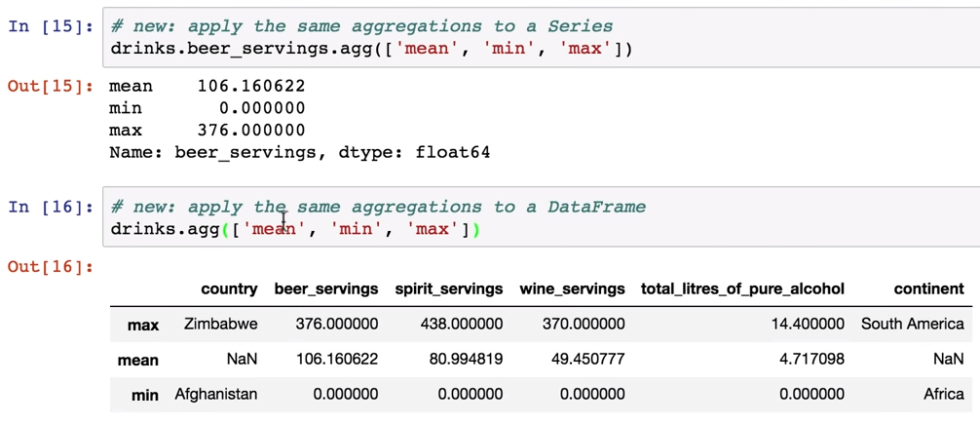

Slide 11
